Slide 1


Final Project Application of RNN for Algorithmic Stock Trading
Patnam, Mohan
CSCI E-89 Deep Learning
Harvard University Extension School
Prof. Zoran B. Djordjević

Slide 2
Problem Statement
Application of RNN for algorithmic stock trading with the focus on short-term price prediction using Tensorflow/Keras API for Deep Learning. A case study of single/multi-variate time-series analysis for a chosen stock and its industry sector (Technology) and the stock market index (S&P500) as a whole.
Stock: MSFT (Microsoft Inc.)
Sector: XLK (Tech Sector ETF) – MSFT is 11.80% of XLK portfolio weight
Stock Market: SPY (S&P 500 ETF)

Slide 3
Data Sample
Date/TimeBin: 2014/01/02 09:51AM (New York Time)
Open – Stock open price 33.1314$ @09:51:00 AM
High – Stock highest price for the minute duration starting 09:51AM
Low – Stock lowest price during the same interval
Close – Stock close price 33.1323$ at the minute end @09:51:59AM
Volume – Stock trading volume in shares for the one-min interval.
Date | TimeBin | Open | High | Low | Close | Volume | Split Factor | Earnings | Dividends
20140102 | 948 | 33.1417 | 33.151 | 33.1323 | 33.1323 | 20582 | 1 | 0 | 0
20140102 | 949 | 33.1323 | 33.151 | 33.1323 | 33.151 | 6675.17 | 1 | 0 | 0
20140102 | 950 | 33.1417 | 33.1417 | 33.123 | 33.1323 | 42184 | 1 | 0 | 0
20140102 | 951 | 33.1314 | 33.1323 | 33.1146 | 33.1323 | 11203.4 | 1 | 0 | 0
20140102 | 952 | 33.1323 | 33.1417 | 33.123 | 33.1417 | 19210 | 1 | 0 | 0
Note: Stock Close price is used in all experimentation

Slide 4
Data Augmentation
DateTime | Close | Volume | Return | Gain | Loss | RSI | CumReturn
1/2/2014 9:30 | 33.6842 | 1319510 | -0.026711621 | 0 | 0.009 | 48.47418 | 0
1/2/2014 9:31 | 33.7157 | 206817 | 0.066779053 | 0.0315 | 0 | 48.47418 | 0.093515654
1/2/2014 9:32 | 33.612 | 227216 | -0.294264221 | 0 | 0.1037 | 48.47418 | -0.214343817
1/2/2014 9:33 | 33.612 | 170074 | 0 | 0 | 0 | 48.47418 | -0.214343817
Augment MSFT data columns
etf.Open | etf.Close | etf.Return | etf.CumReturn | spy.Open | spy.Close | spy.Return | spy.CumReturn
33.2818 | 33.2164 | -0.196503795 | 0 | 170.607 | 170.524 | -0.048649821 | 0
33.2164 | 33.2024 | -0.042147855 | -0.042147855 | 170.524 | 170.529 | 0.002932139 | 0.002932139
33.2071 | 33.2071 | 0 | -0.027998218 | 170.524 | 170.589 | 0.038117802 | 0.038117802
33.2164 | 33.2118 | -0.013848581 | -0.013848581 | 170.58 | 170.598 | 0.010552234 | 0.043395651
Augment XLK data columns
Augment SPY data columns
Return – Stock one-min returns (%)
CumReturn – Stock cumulative return (%)
RSI – Relative Strength Index to indicate whether stock is oversold or overbought.
Gain/Loss – Intermediate columns needed for RSI calculation

Slide 5
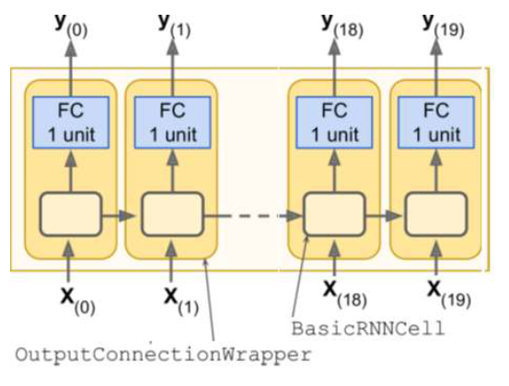
RNN Model
At each time step, we have an output vector of size 100. However, we want one single output representing the stock price.
We will use OutputProjectWrapper with a FC layer to convert output vector to single output value.
#Time steps = 780
Each RNN cell:
#Inputs = 1 (single variate)
#Inputs = 2 (multi-variate)
#Neurons = 100
#Outputs = 1

Slide 6
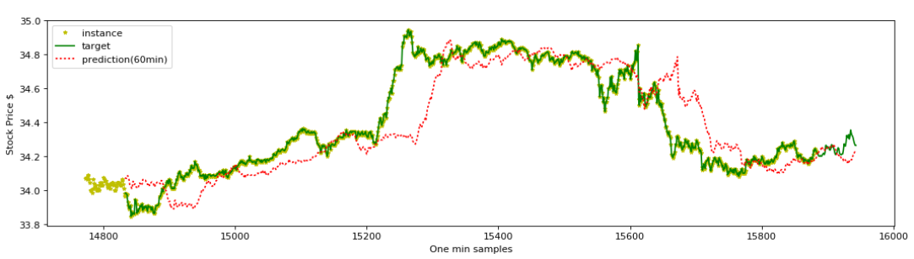
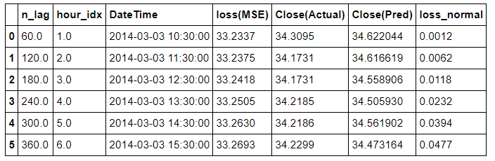
Single Variate Time Series Prediction
Task:1 Use MSFT one-minute Stock close price ($).

Slide 7
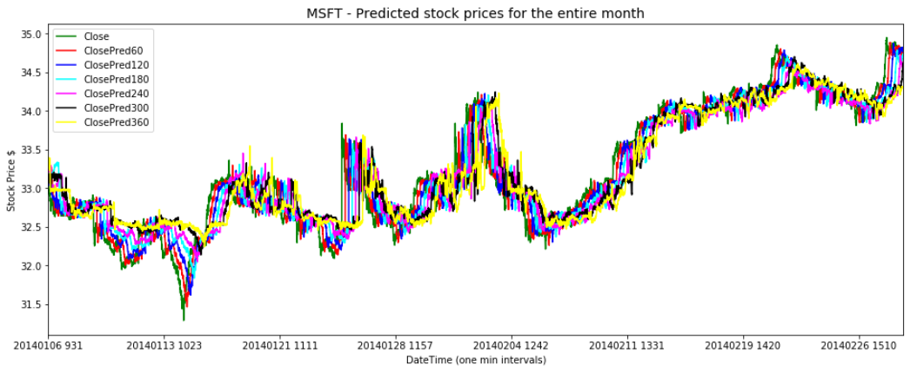
Single Variate Time Series Prediction
Task:1 Prediction of stock prices with different lag -
60min, 120min, 180min, 240min, 300min, 360min
We see that the predictions getting worse as the prediction window grows. We do see that the predictions have picked-up for short term (60min window) and overall, picked the long-term patterns.

Slide 8
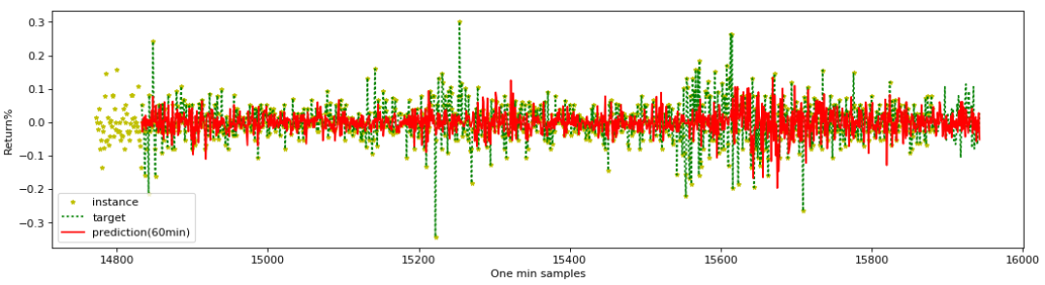
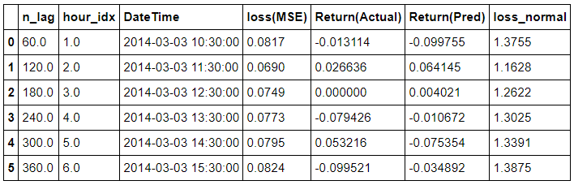
Single Variate Time Series Prediction
Task:2 Use MSFT one-minute Stock returns (%gain or loss).

Slide 9
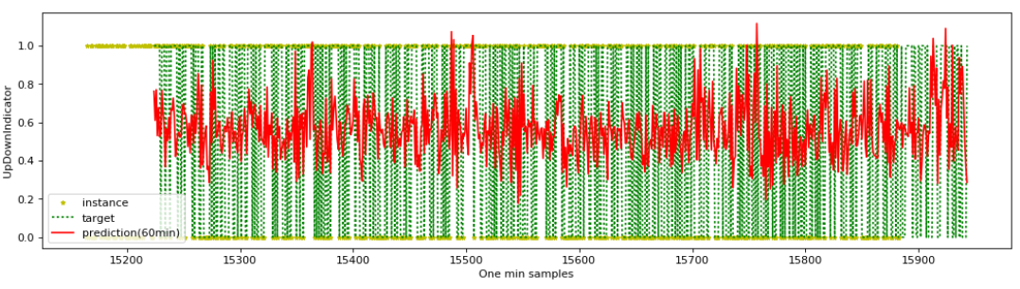
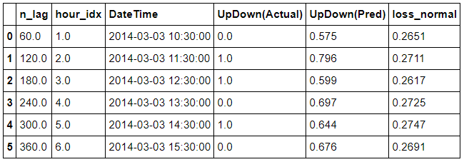
Single Variate Time Series Prediction
Task:3 Use MSFT Stock Up/Down Indicator

Slide 10
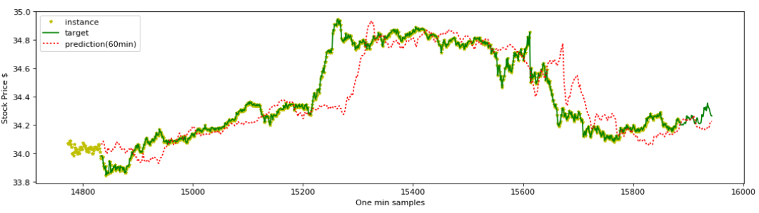
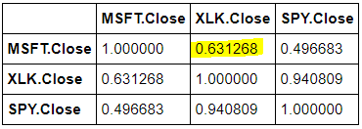
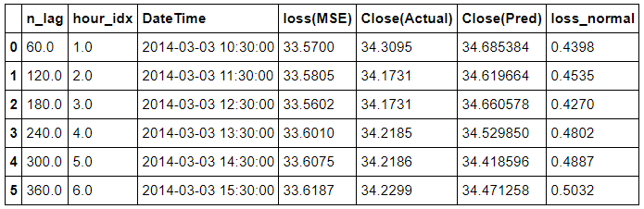
Multi Variate Time Series Prediction
Task:4 Effect of XLK prices on MSFT price for the same period (2014/01 to 2014/02) as single-variate analysis (Task:3)

Slide 11
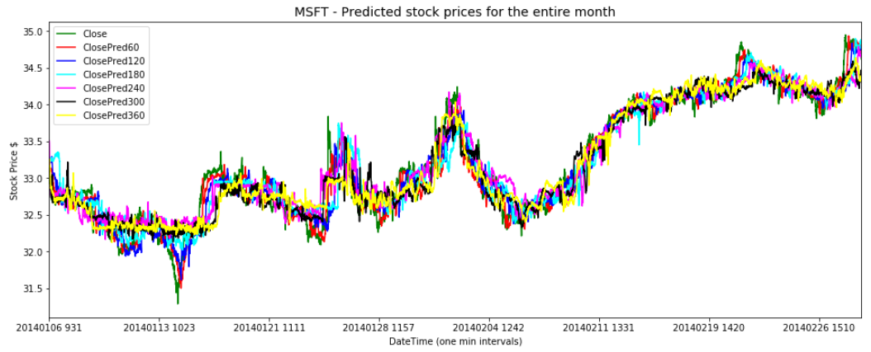
Multi Variate Time Series Prediction
Task:4 Prediction of stock prices at different lags
60min, 120min, 180min, 240min, 300min, 360min
We see that the predictions getting worse as the prediction window grows. We do see that the predictions have picked-up for short term (60min window) and overall, picked up the long-term patterns.

Slide 12
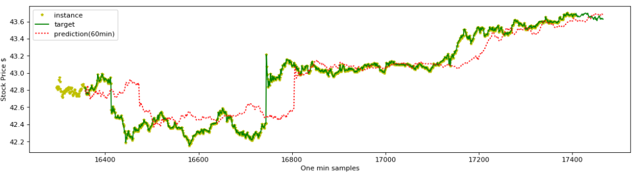
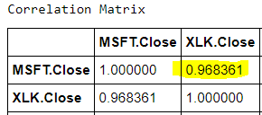
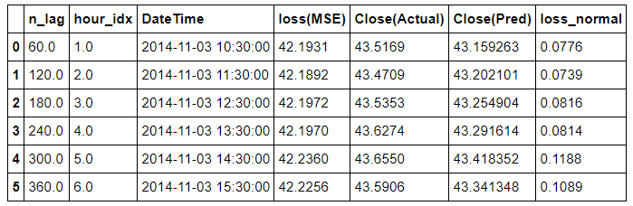
Multi Variate Time Series Prediction
Task:5 Effect of XLK prices on MSFT price for the period when XLK and MSFT are best correlated (2014/09 to 2014/11).

Slide 13
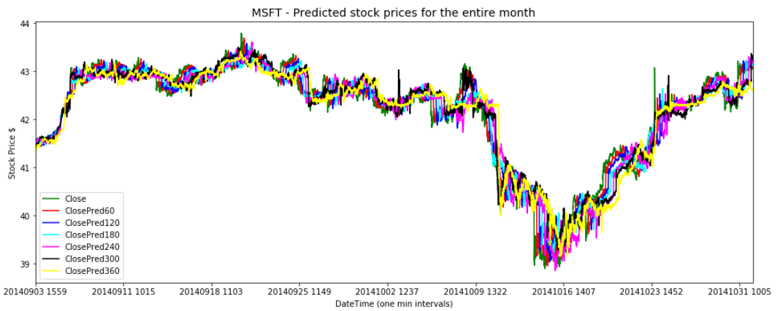
Multi Variate Time Series Prediction
Task:5 Prediction of stock prices at different lags
60min, 120min, 180min, 240min, 300min, 360min
Predictions overall very tight and remains same regardless of window size. Performance relatively better compared to the single-variate analysis. Predictions have picked-up for short term (60min window) and overall, picked long-term patterns.

Slide 14
Conclusion
Presented a general pipeline of data download, wrangling and normalization for single vs multi-variate time series prediction using one-min stock prices, trained appropriate RNN based models in each case with varying parameters.
Performed multiple experiments ranging from prediction of stock price direction (up/down) in the near future to the prediction of stock prices and returns %.
Summary of results:
Evaluated the model with two different time-steps (5 days vs 2 days) and observed performance remaining same.
Single Variate (using MSFT price):
The model that predicted stock prices in the near future performed better compared to predicting stock movement (up/down) or stock returns (%).
Multi Variate (using MSFT + XLK prices):
Adding a correlated variable (XLK price) as additional input has shown improvement with a lower loss (MSE).

